Slide 1
High Resolution Separator for Spiral2
Design and performances
Laurent Serani
On behalf of the HRS Working Group

Slide 2
Contexte
Données entrées
Pourquoi ce spectro
Transmission total, online faisceau ISOL basse énergie
Système dispersif/remplissage dipôles
Laurent Serani Brookhaven National Lab June 5 2012

Slide 3
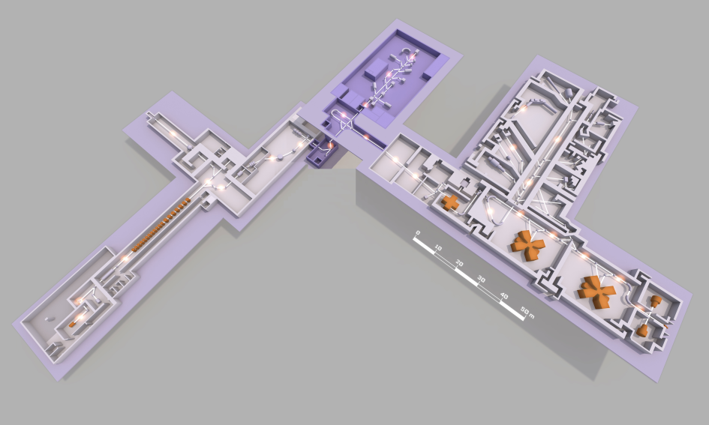
Contexte
DESIR PROJECT
Desintegration Excitation and Storage of Radioactive Ions

Slide 4
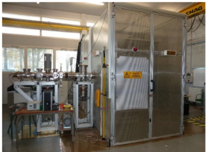
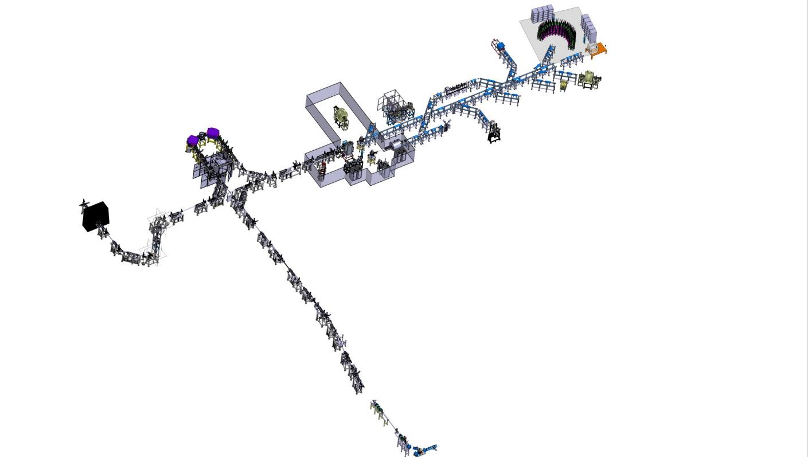
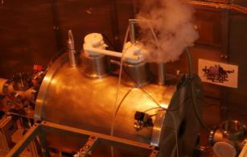
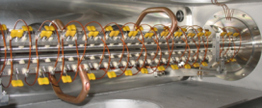
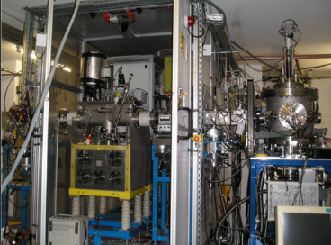
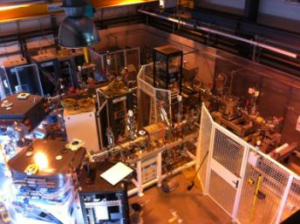
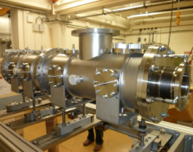
Contexte
Two sites of Production with fento to pico Amps beams intensity
Broad Species
Transportation energy at 60keV
Need to have a setup with good resolution and hight efficiency
PIPERADE au CENBG
SHIRAC2 au LPC Caen
LPCTrap au GANIL
HRS1P et GPIB au CENBG
Section optique à l’IPNO

Slide 5
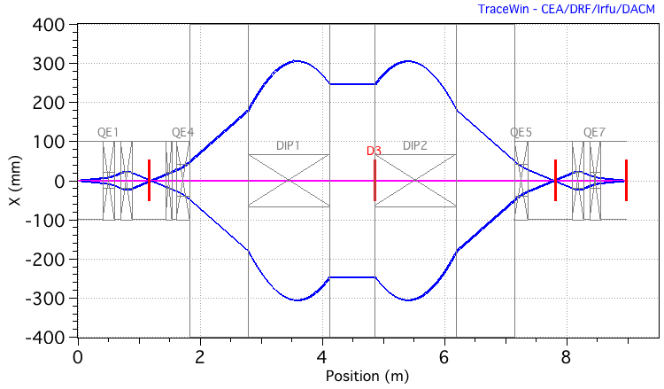
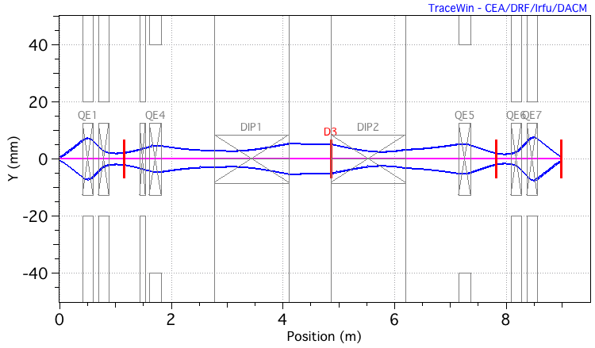
DESIR-HRS @SPIRAL2
HRS: a U180 Mass Spectrometer
DESIGN:
U design: to be compact
Mirror Symmetry : eliminer les abération d’ordre paire
1 to 1 transportation: try to
Large Dipôle: to increase the mass dispersion capacities
Notes:
5
5
5

Slide 6
HRS: a U180 Mass Spectrometer
The quadrupole doublet matching section produces a ribbon-shaped beam, so y-angles are small, minimizing b aberrations
The first quadrupole diverges in x and converges in y, giving a small y size which minimizes coupling aberrations
The large x area in the magnets gives mass dispersion
Traznsportation conditions in centre: (a|a)=(y|b)=(b|y)=0
The reverse matching section transforms the ribbon-shaped beam back to a circular cross-section, allowing a 1 mm x-selection slit at the focal plane
The multipole to correct aberrations to 5th order
Expected performances:
Resolution of 20000 at 1Pimmmrad
Acceptance:5Pi
Transmission: close to 100% at 1Pi

Slide 7
Transmission and cross-contamination First Approch with Turtle code
X-Y phase space for isobars with mass deviations -1/20000, 0, +1/20000 .
1 π mm.mrad
3 π mm.mrad
97% transmission,
0.09% cross-contamination
77% transmission,
1.4% cross-contamination
Laurent Serani Brookhaven National Lab June 5 2012
Notes:
7

Slide 8
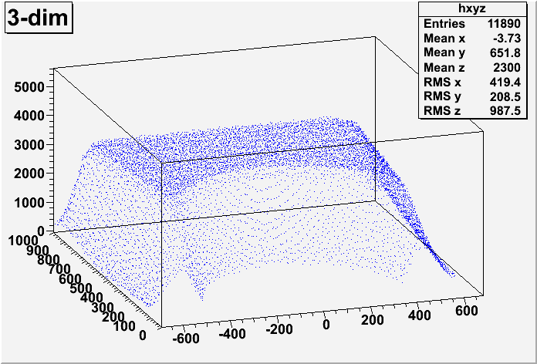
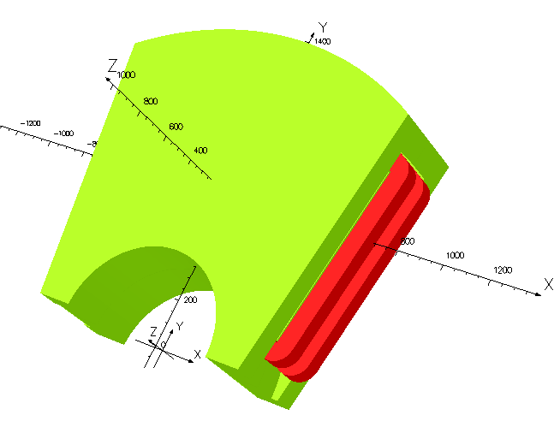
TOSCA Field map for dipoles Toward the real life
Maurice Duval,
Marc-Hervé Stodel
GANIL
Change from matrix calculations: TRANSPORT,COSY, GCOSY
To
ZGOUBY integrating track evolution
Laurent Serani Brookhaven National Lab June 5 2012

Slide 9
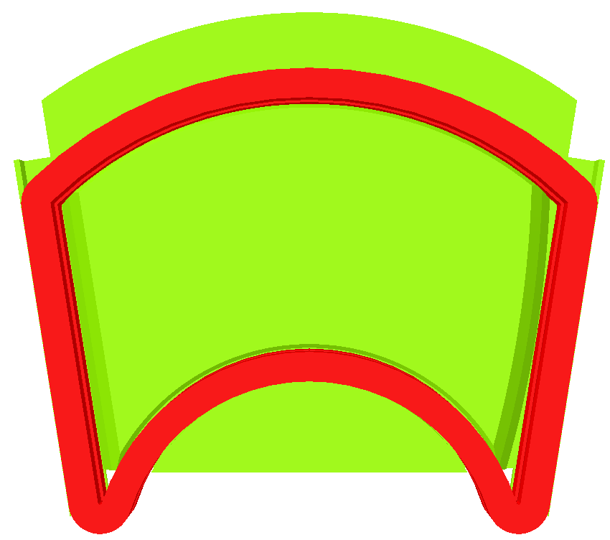
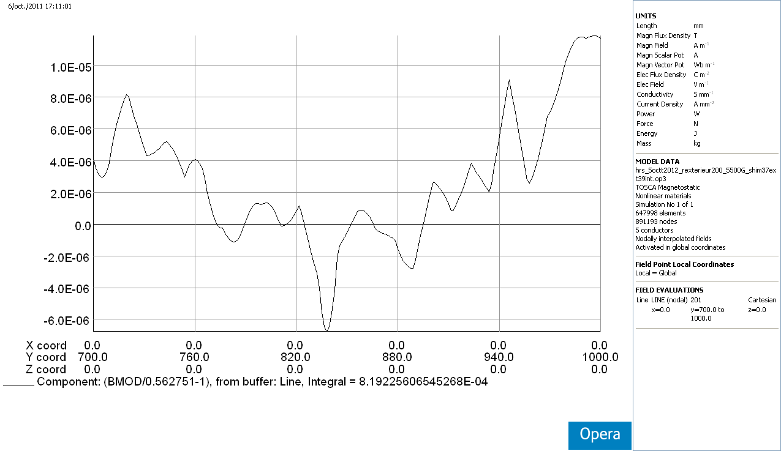
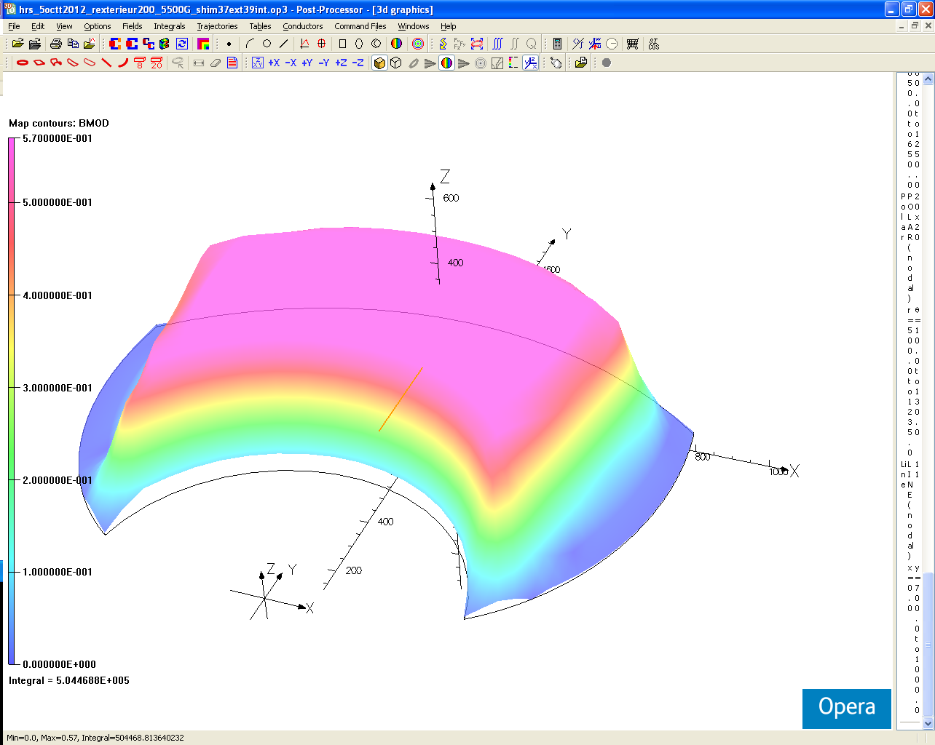
Dipole Magnets
Homogeneity 1.6 10⁻⁵
300mm
0.09 Gauss !!!
Maurice Duval,
Marc-Hervé Stodel
GANIL
Machining precision needed:
Pole faces Parallemlism : 10µm
Poles positionning: 50µ m
Laurent Serani Brookhaven National Lab June 5 2012

Slide 10
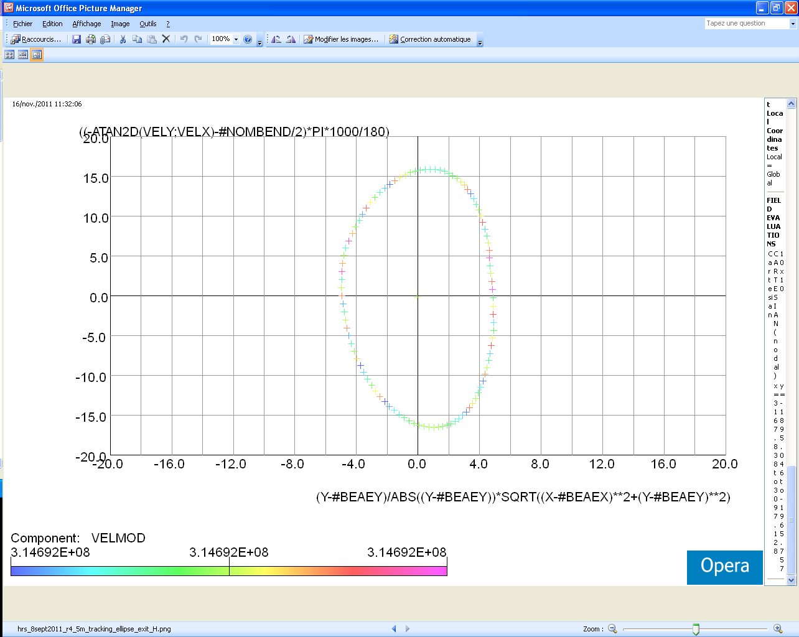
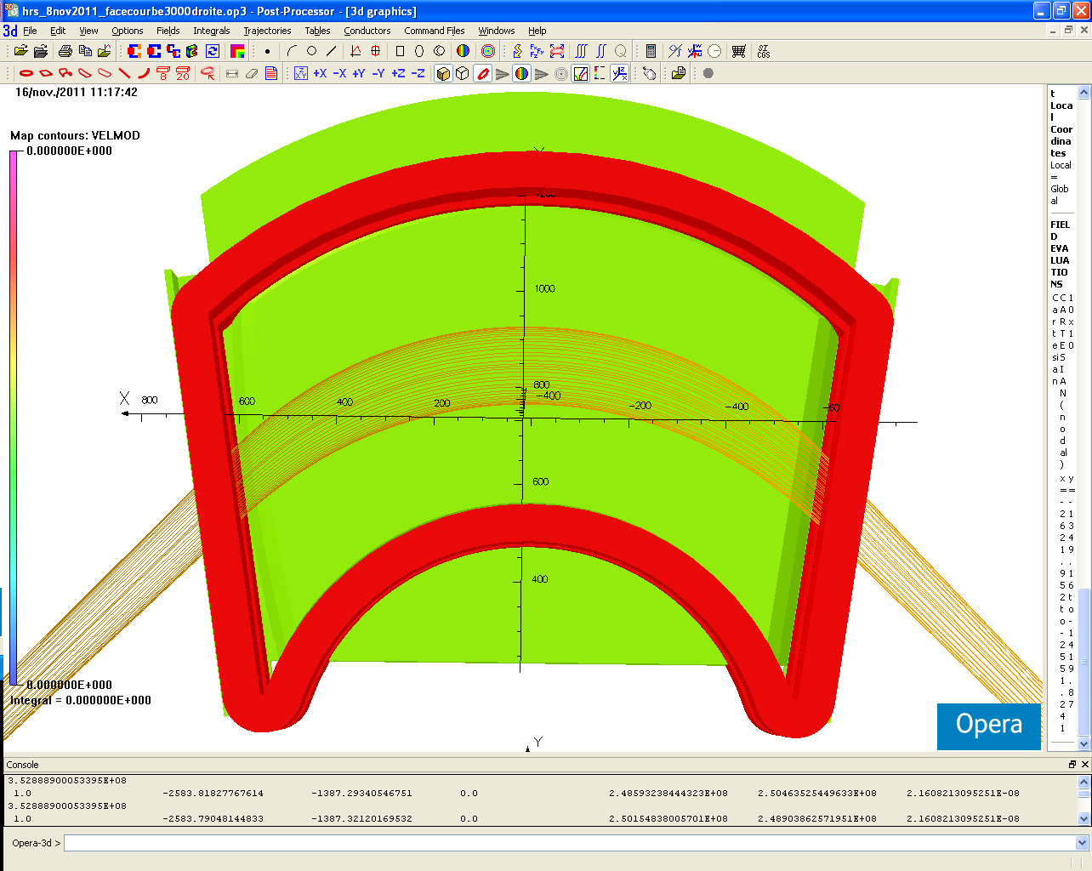
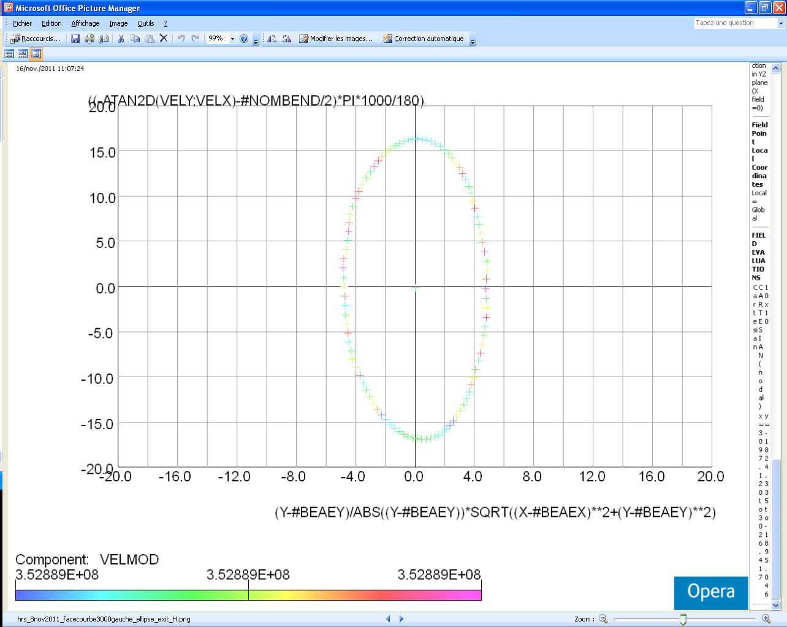
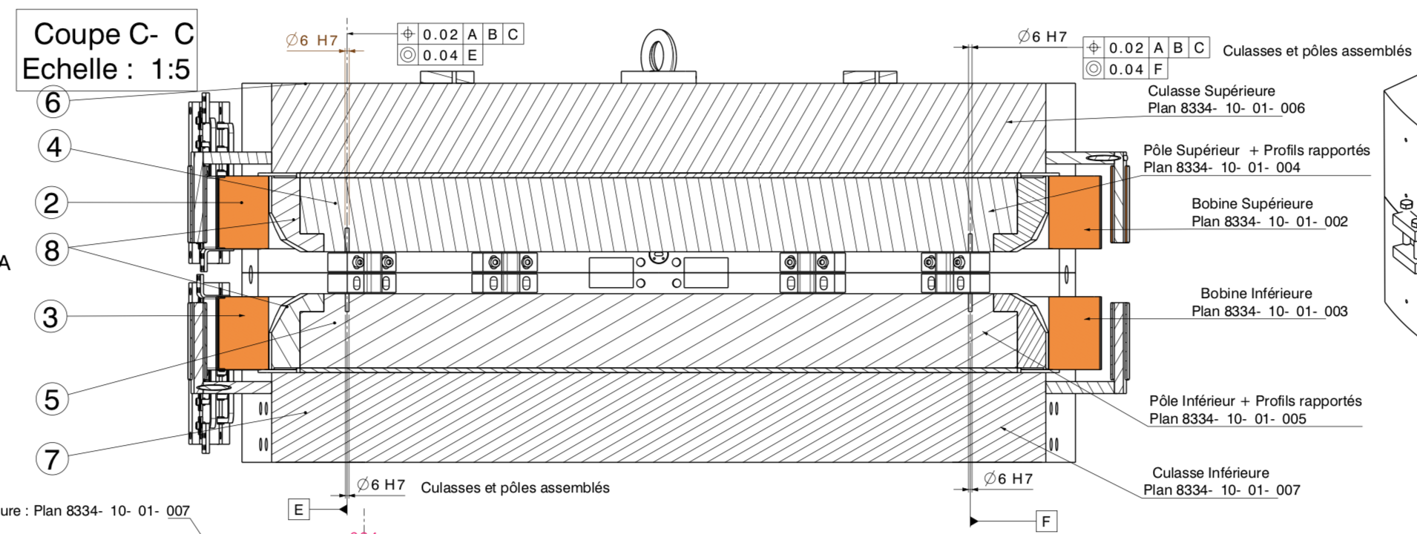
Correction of the 2nd intrinsec order
Pole curvature R
R=4500mm
R=3000mm
Input
Dipole of Zgoubi to fix this parameter
of the development plan like SPES2
at begining

Slide 11
Way to real life
Tosca Map
Going across the Dipole at z=2cm
Quadrupole with Fringe Field
Going across at z=1.5cm
Not necessary for the preliminary
design but request for the final design
Laurent Serani Brookhaven National Lab June 5 2012

Slide 12
At Focal Plane: Phase Space Y versus Y’
Visualization of aberration order with a first
correction of C² by pole radius curvature
With Multipole on
With Multipole off

Slide 13
Resolution after roughly aberrations correction at the focal plane
R=4m on both side of each Dipole
Without correction with the Multipole
R=4m on one side of each Dipole
+ correction with the Multipole
If the Life is as Zgoubi, the Life will be great

Slide 14


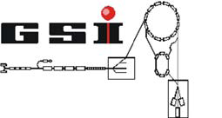
DESIR-HRS working group:
Blank, B. Scientific coordination
Delalee, F. Mechanical Design
Kurtukian-Nieto, T. Optic Design
Daudin L. & Alfaurt P. CC and PLC
Serani, L. Project Leader, Optic Design
Thank You for your attention
Duval, M. Magnet Design
Stodel, M.-H. Magnet Design
Varenne, F. Optic Design
Méot, F. Optic Design
Weick H. Optic Design
Notes:
14

